Slide 1
Managing Technology
Managing Research Function

Slide 2
Chapter Objectives
Explain product and technology life cycles
Describe the legal means to protect a person’s ideas
Analyze the nature of creativity

Slide 3
Advanced Organizer

Slide 4
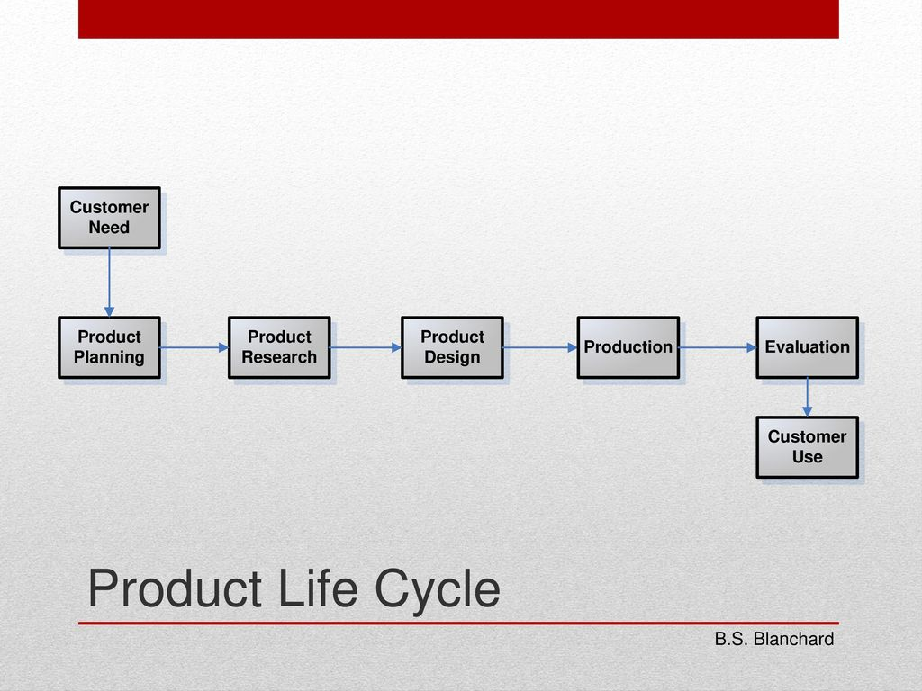
Product and Technology Life Cycles

Slide 5
Product Life Cycle
Useful for the construction of a building or a ship or the design and development of an aerospace system.
Consumer | Identification of need | "Wants or desires" for product (deficiencies/problems are made evident through basic research
 | Planning function | Marketing analysis, feasibility study, product selection, specification and plans, evaluation plan, logistic support plan, planning review and proposal
 | Research function | Basic research, applied research, evolution from basic research to product design and development
Producer | Design function | Design requirements, conceptual design, preliminary system design, detailed design, engineering model/prototype development to production
 | Production and/or construction | Production and construction requirement, industrial engineering, plant engineering, manufacturing, production and quality control.
 | Product evaluation | Evaluation requirements, categories of test and evaluation, formal test and evaluation, data collection, analysis, reporting and correction, retesting
Consumer | Product use and logistic support | Product distribution, operational use, maintenance support, product evaluation and modification, product phase-out, material disposal, reclamation and re-cycling

Slide 6
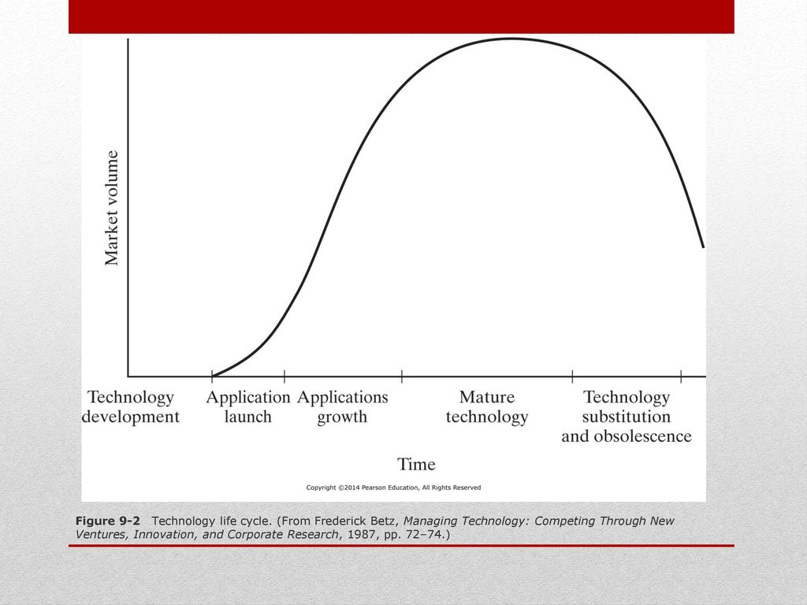
Technology Life Cycle
For a product line based on a technology that is developed and improved over a period of years of product manufacture

Slide 7
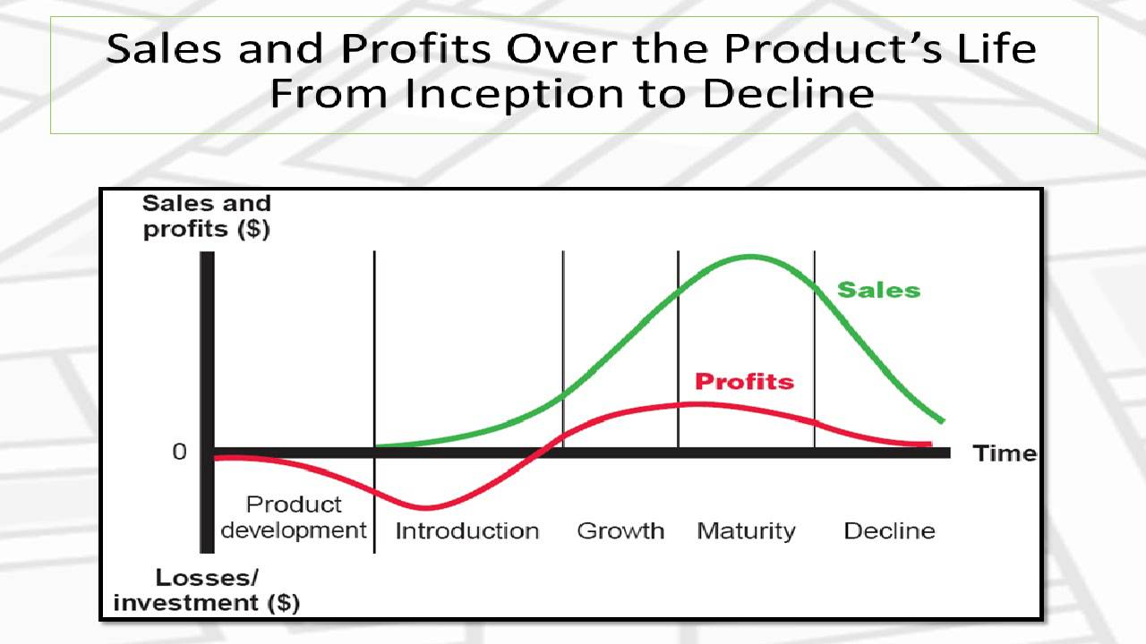

Slide 8
Nature of Research and Development
Research
Systematic, intensive study directed towards scientific knowledge of the subject studied.
Basic Research
Devoted to achieving a fuller knowledge or understanding rather than practical application of it.
Applied Research
Directed towards practical application of knowledge – especially for industry culminating into products
Development
Systematic use of scientific knowledge directed towards the production of useful materials, devices, methods, products etc.

Slide 9
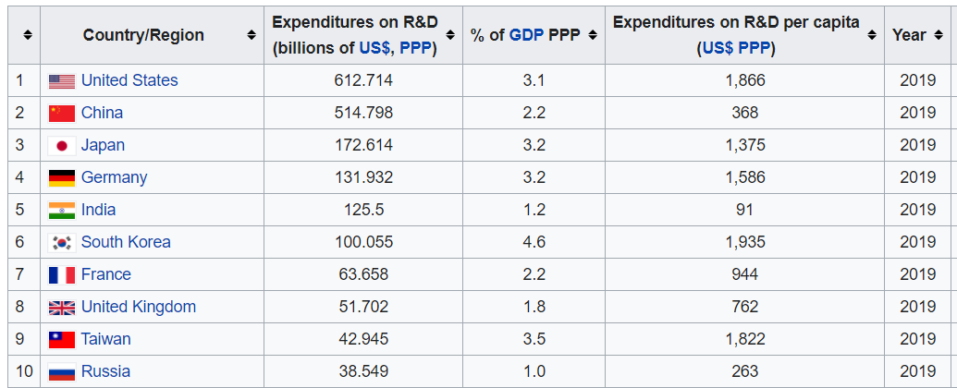
List of countries by research and development spending (2019) , Source Wikipedia

Slide 10
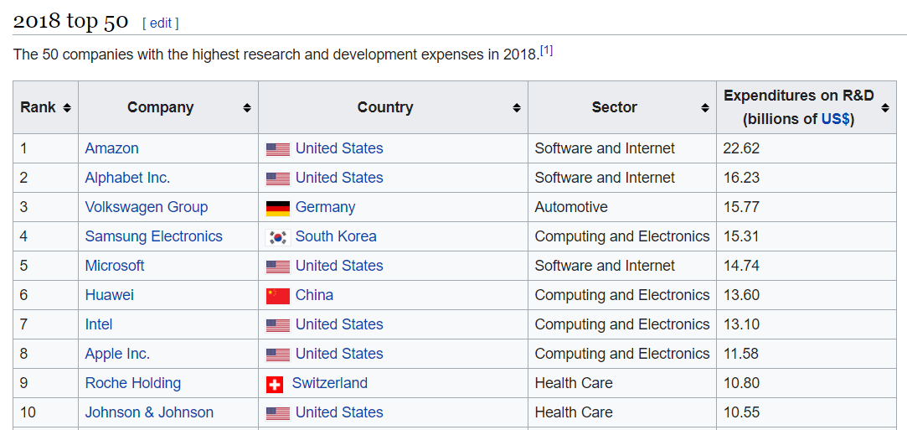

Slide 11
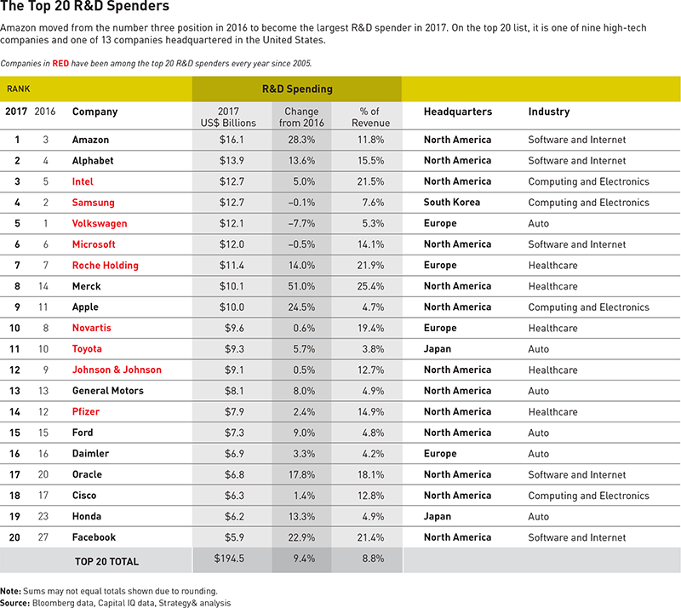

Slide 12
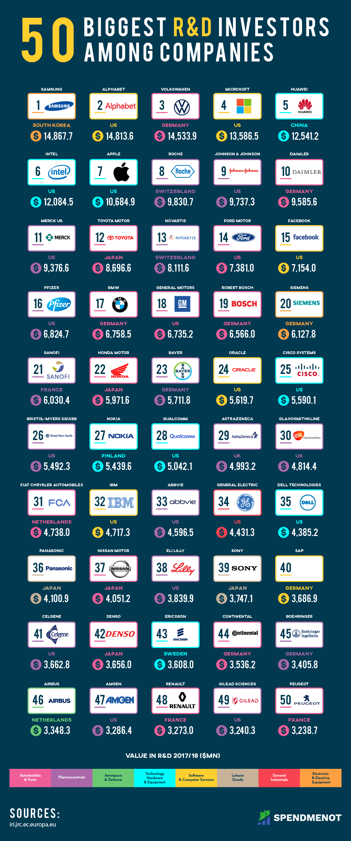

Slide 14
New Product Strategies as suggested by Ansoff and Stewart
First to Market
High expenditure before there is guarantee of success. Heavy development expenditure and a large marketing effort – the rewards are immense
Follow the leader
Strong development engineering but less on research – follows the competitor’s research success – brings product with innovator –
Me too
No research and development – simply copying the design from others, buying and leasing necessary technology
Application engineering
Taking established product and produce in customer’s desired design and need - needs high flexibility in production

Slide 15
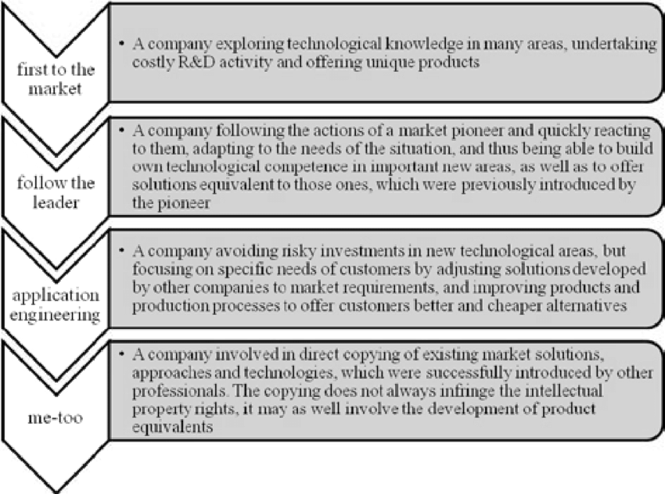

Slide 16
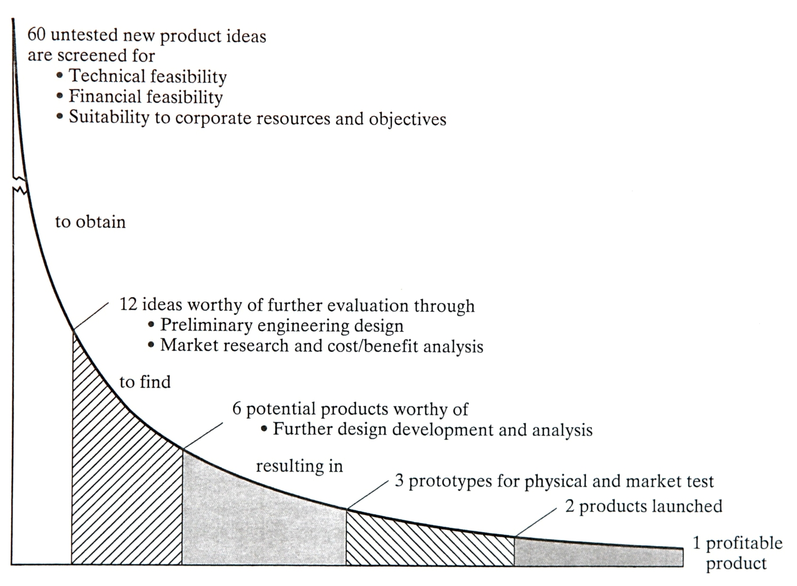
Selecting R&D Projects

Slide 17
Selecting R&D Projects – Initial Screening
In ‘simple checklist ‘, project is given simple judgemental rating (poor/ fair /good/excellent or -2/ -1/ +1/ +2) for each of characteristics and in ‘weighted checklist’ or ‘scoring model’, each characteristics is provided with weight showing importance of that factor.

Slide 18
Selecting R&D Projects – Initial Screening
Technical factors: availability of needed skills and facilities; probability of technical success
Research direction and balance: compatibility with research goals and desired research balance
Timing : Is R&D and market development relative to the competition?
Stability : Potential market and economic condition
Position factor : How are other products faring
Market growth: Will there be a viable demand?
Production: can the items be produced with current manpower and set-up?
Marketability: Marketing organization, distribution methods and customer makeup.
Patentability: Can the product be patented?
Financial factors: expected investment need and rate of return

Slide 19
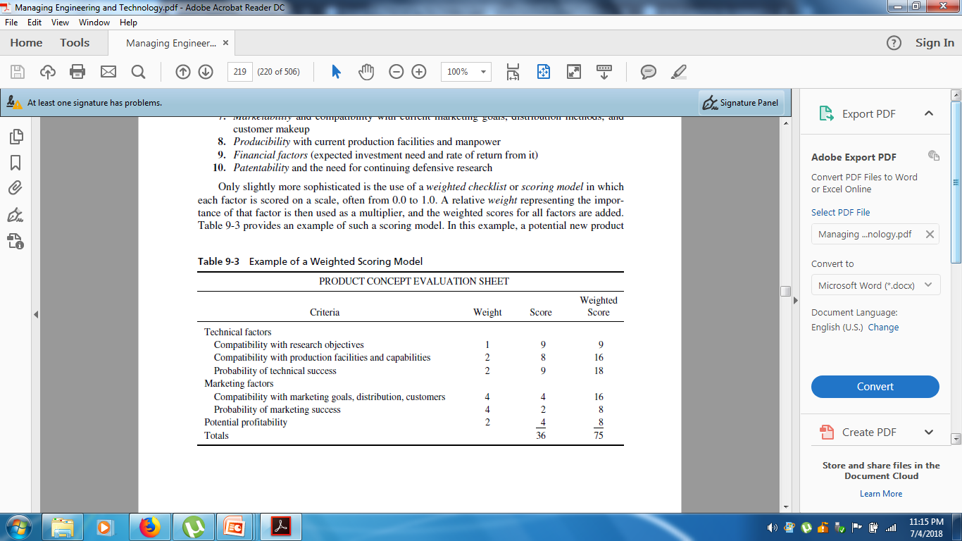

Slide 20
Quantitative Approaches
Payback Period For short term investment
Ignores time value of money and profit beyond the point of pay back
Payback period ( T_{pb} ) = Investment ( I) / Annual Gross profit ( A)
Present Worth Method
n
P = ∑ A_{j}
j=1 (1+i)^{j} where, P= Present worth of future cash flow
A=cash flow in j^{th} year
i = minimum attractive rate of return
n= number of year of future cash flow
Maximum expenditure justified
E_{mj} = F_{c} ∗ F_{t} ∗ P
= P_{commercial success} ∗ P_{tech. success} ∗ NPW

Slide 21
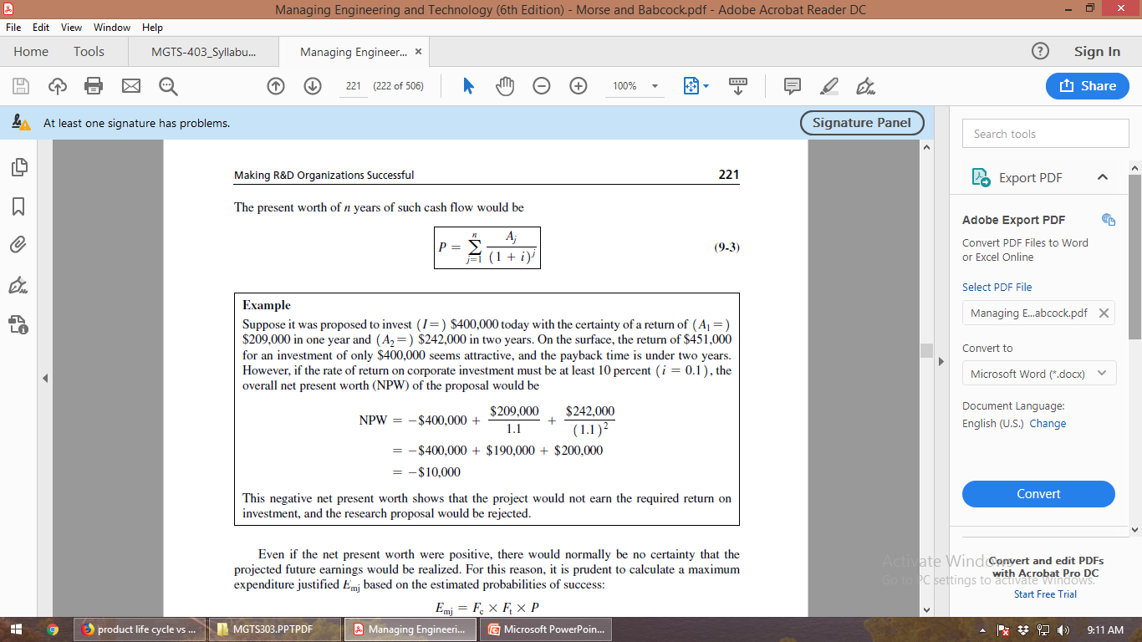

Slide 22
Making R&D Organizations Successful
R&D Business Strategy
Carefully planned technology strategy must be considered to support the overall strategy of the enterprise.
Erickson et al. indentify “three broad classes of technologies” a typical firm must consider:
Base Technologies – a firm must master these technologies to be effective in the chosen market
Key Technologies – provide competitive advantage by embedding differentiating features or functions
Pacing Technologies – may become key technologies later, these differentiate leader from follower

Slide 23
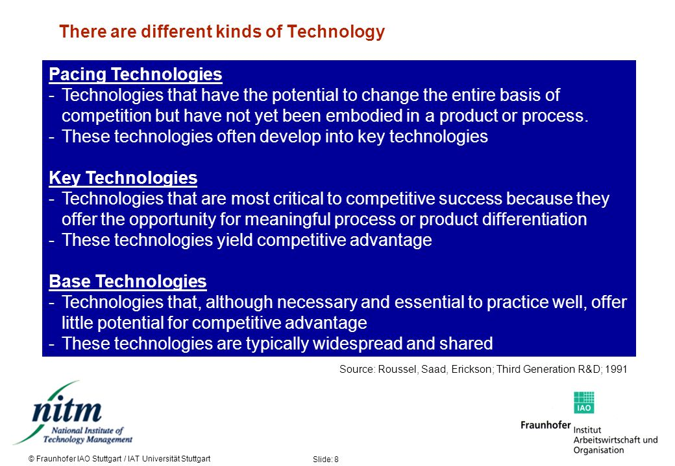

Slide 24
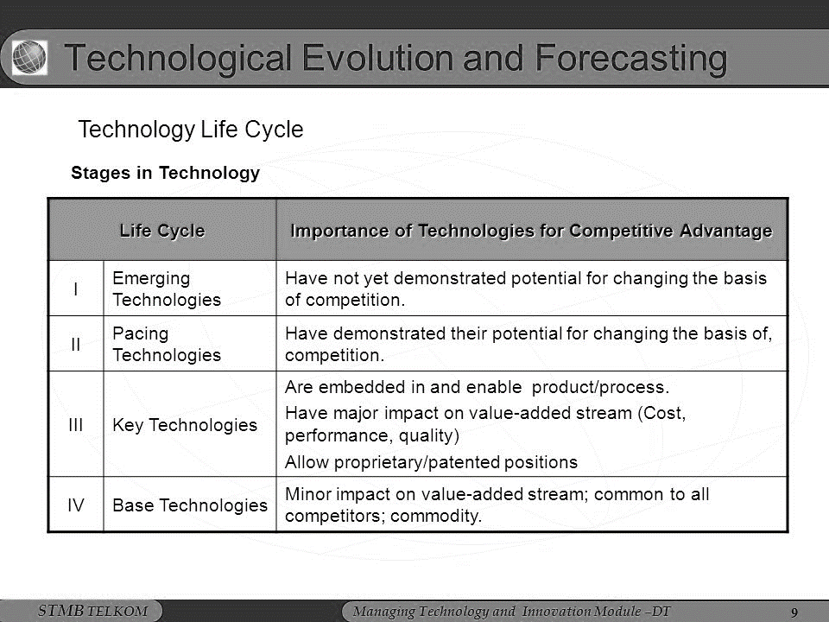

Slide 25
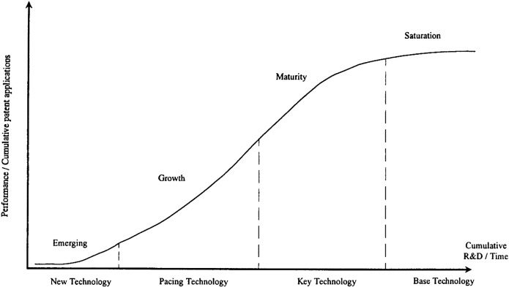

Slide 26
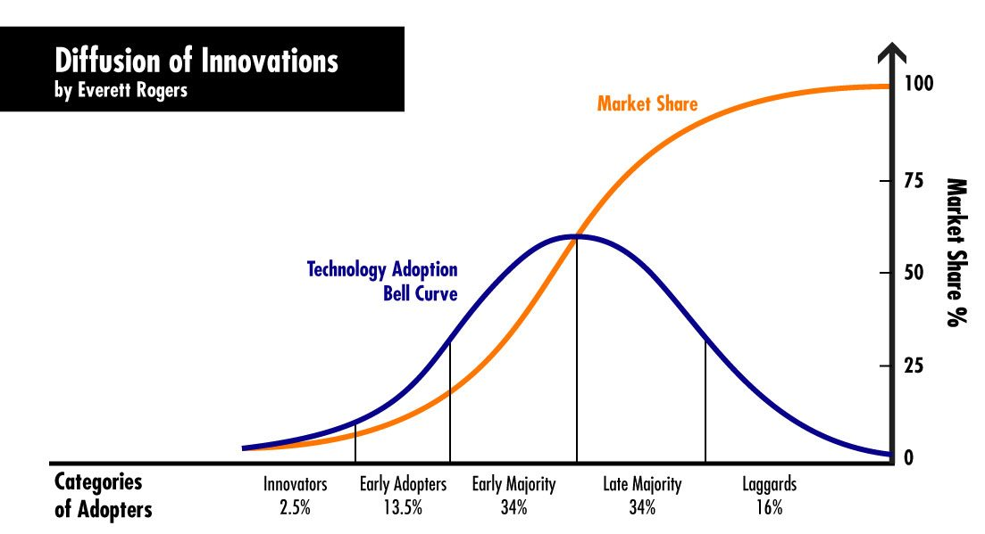

Slide 27
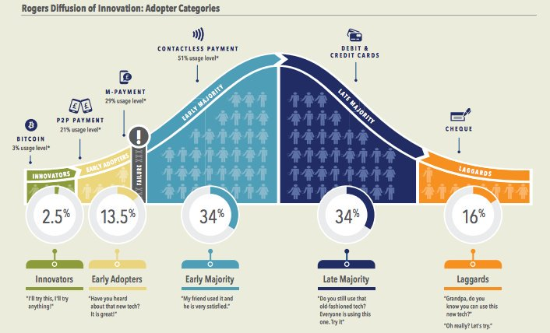

Slide 28
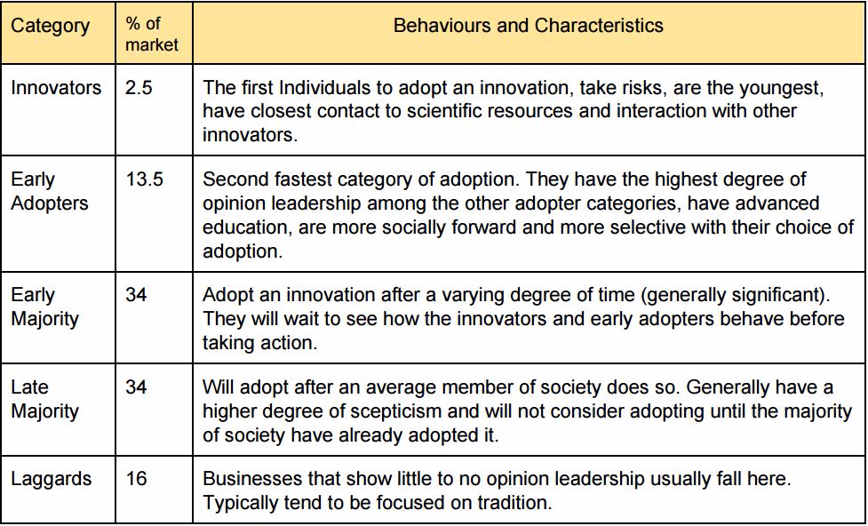
Types of Technology Adopters

Slide 29
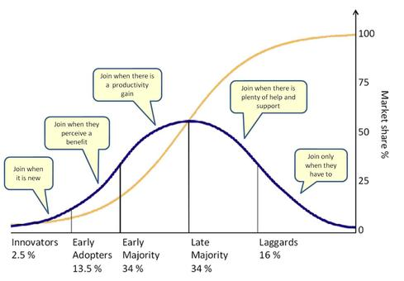
Technology Adoption Curve

Slide 30
Evaluating R&D Effectiveness
Organizational Effectiveness
Ratio of research costs to profits
Percentage of total earnings due to new products
Share of market due to new products (usually computed as the volume of sales from a firm’s new products in a specific product market to the total sales available from that market, which confounds the measure by including marketing proficiency as well)
Research costs related to increases in sales
Research costs to ratio of new and old sales
Research costs per employee
Ratio of research costs to overhead expenses such as administrative and selling costs
Cash flows (continuing evaluation of the pattern of outflows for research expense and actual and projected inflows from resulting revenue)
Research audits, including indicators of administrative and technical objectives such as costs, time, completion dates, probability of technical success, probability of commercial success, expected market share, expected profits, expected return on investment, design, and development. Blake provides a checklist of questions to ask in such an audit.
Weighted averages of costs and objectives (a measure of the extent the average R&D dollar contributed toward objectives with weights on a scale, such as 0.0 equals project badly missed objectives to 3.0 equals project far exceeded objectives)
Project profiles (a more complex weighted scoring of each project, using criteria such as those in the research audits, item 9).

Slide 31
Individual Effectiveness
Evaluated by the normal techniques of performance appraisal, especially management by objectives (MBO), emphasizing research goals.
Quantitative measures – the number of patents and publications, and citation by others of those publications, etc.

Slide 32
Making R&D Organizations Successful
Support for R&D. Quality supporting services need to be supplied to make the work of the highly trained scientist and engineer more efficient and productive.
Technical support to carry repetitive testing and other functions – low skilled level manpower
Support of mechanics, glassblowers, carpenters to produce test and research equipment
A technical library with the field of research
Technical publication support including typing, editing, graphical support for report production
A flexible system for procuring researcher’s equipment and materials
Computer facilities and programming assistance
A strong internal commercialization process in place to take research to product

Slide 33
Protection of Ideas
Strategic planning for competition requires protecting innovation
Development of organizational goodwill also is for competitive advantage
There are four legal means to protect individual or organizational ideas and rights
Patents
Copyrights
Trade secrets
Trade marks and other marks
The law associated with these protection is called intellectual property law

Slide 34
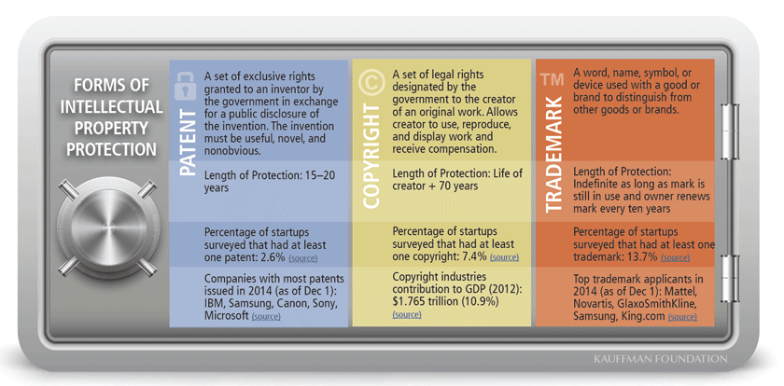

Slide 35
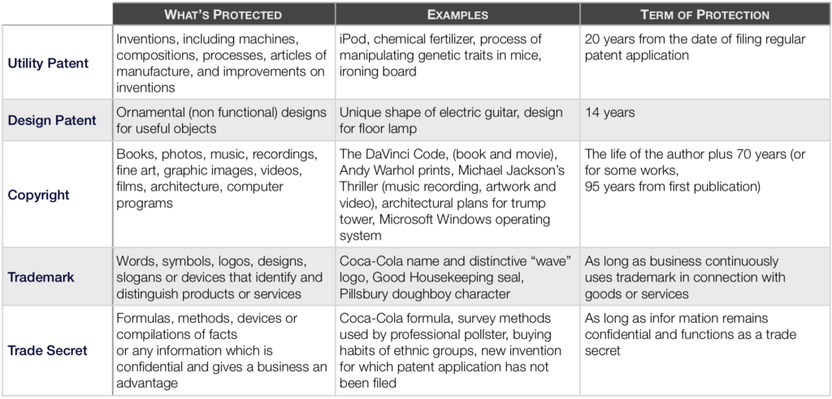

Slide 36
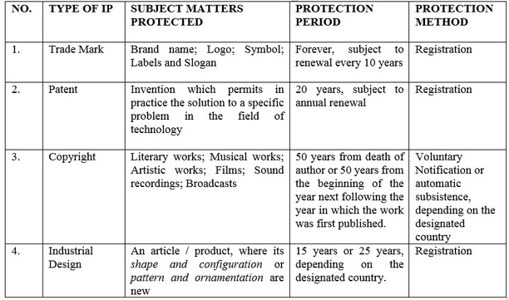

Slide 37


Slide 38
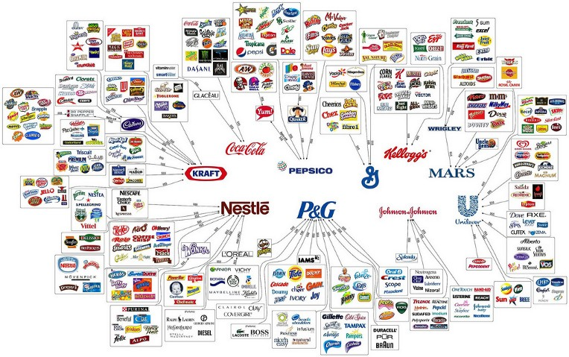

Slide 39



Slide 40
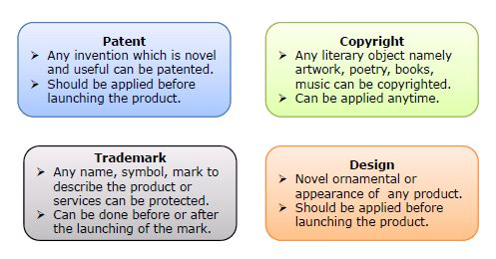
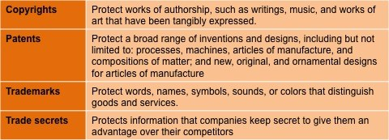

Slide 41
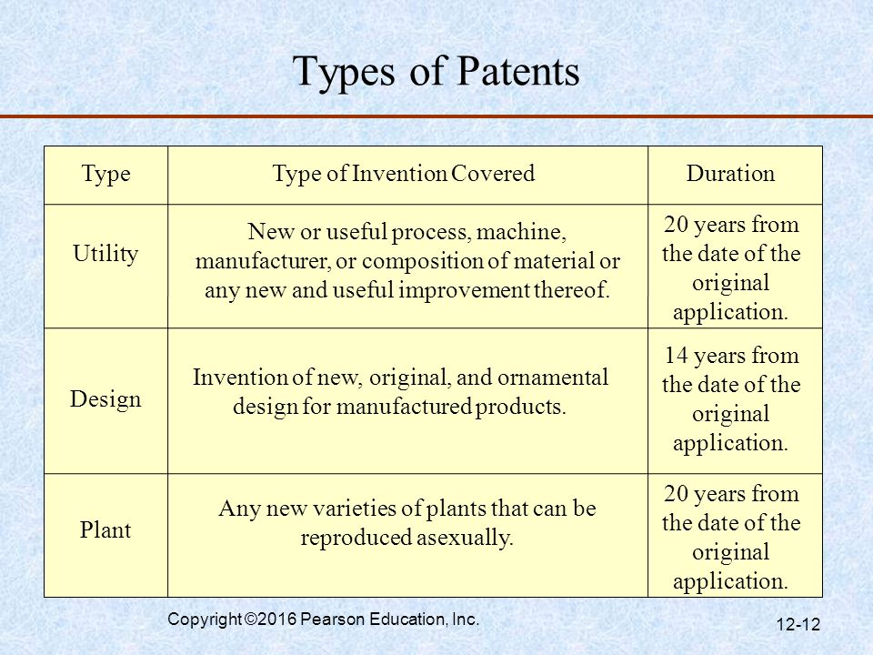
Types of Patents

Slide 42
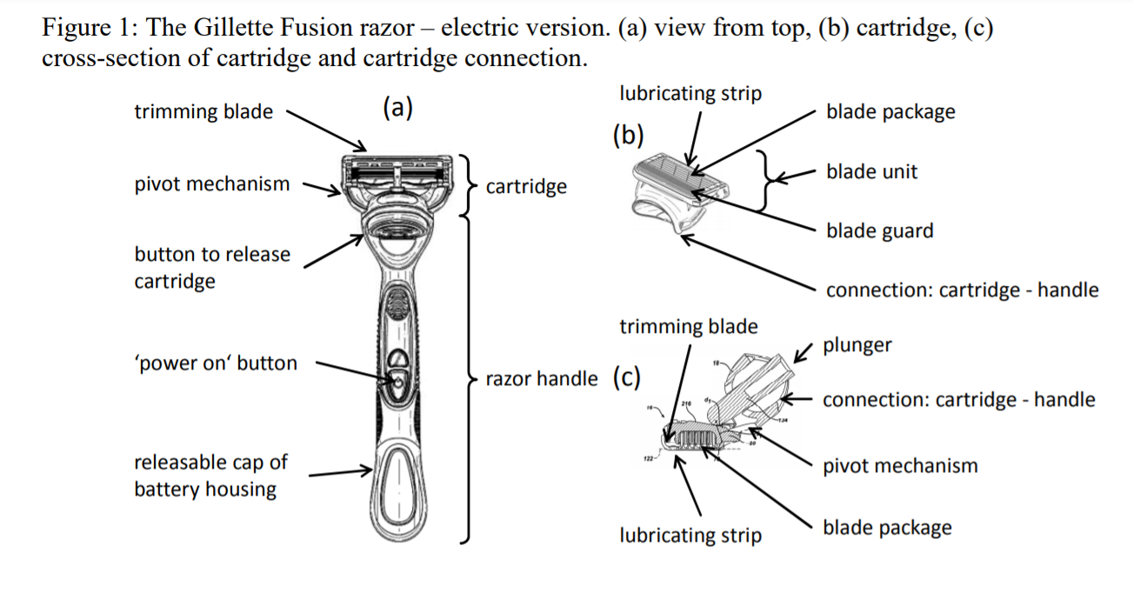

Slide 43
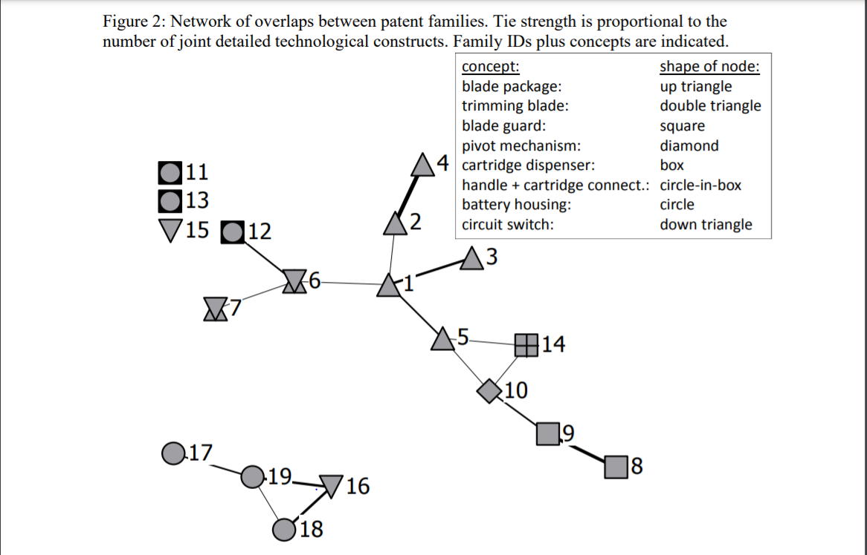

Slide 44
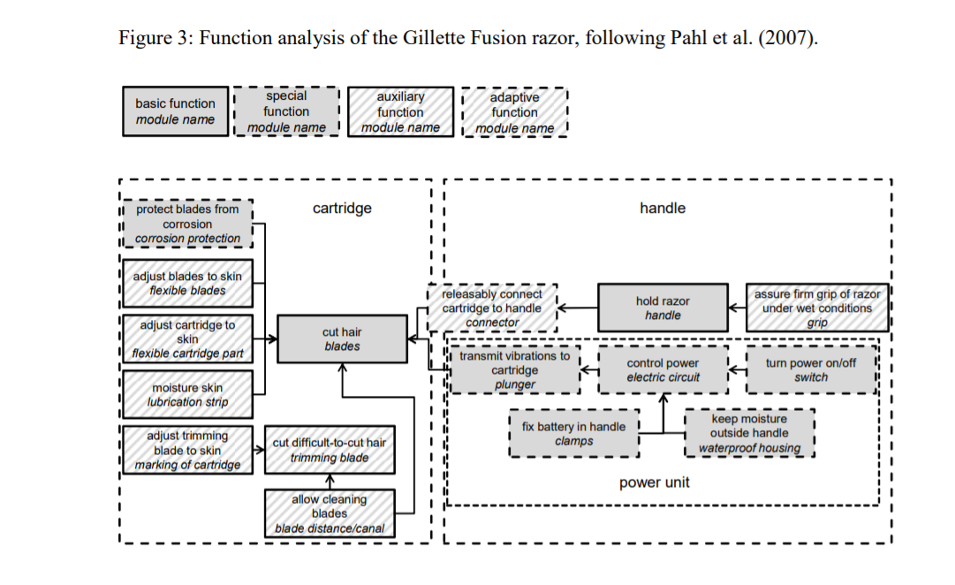

Slide 45
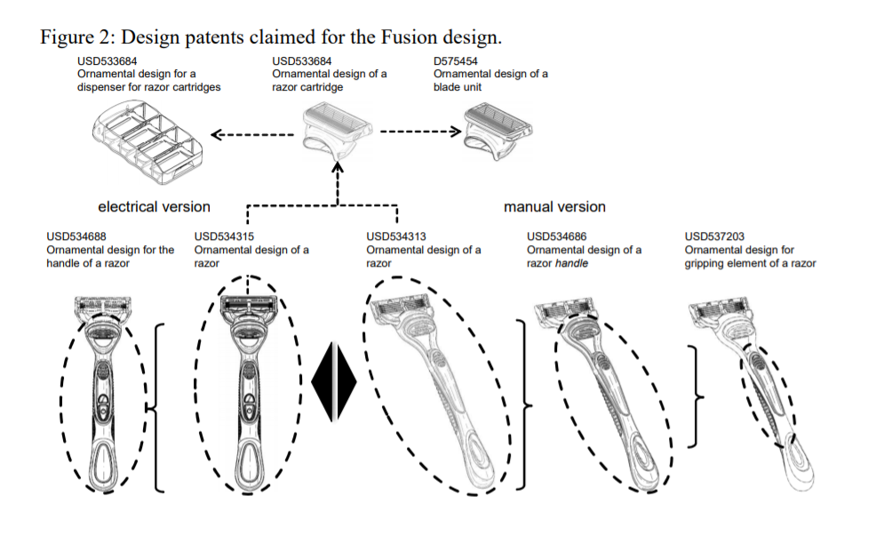

Slide 46


Slide 47
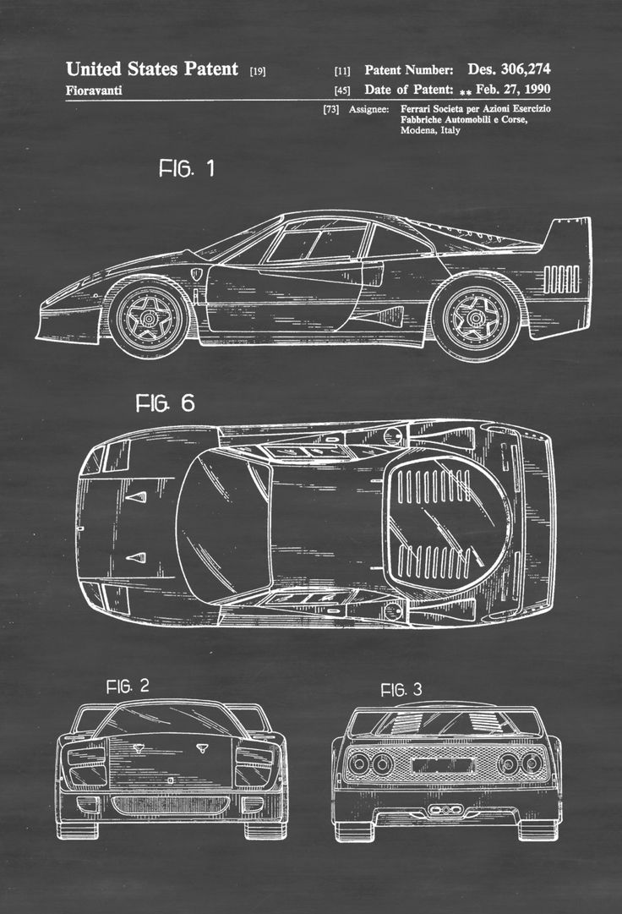

Slide 48
IP Ownership
Trade Marks – The applicant is the owner.
Patents – Inventor owns the IP, unless the invention was made as part of his/her job, in which case his/her employer will own the invention.
Designs – The designer is the owner, unless the design was made as part of his/her job, in which case his/her employer will own the invention. A commissioned design is owned by the designer and not the commissioner (unless a contract states otherwise)
Copyright – The creator of the work is the owner, except where made in the course of employment.

Slide 49
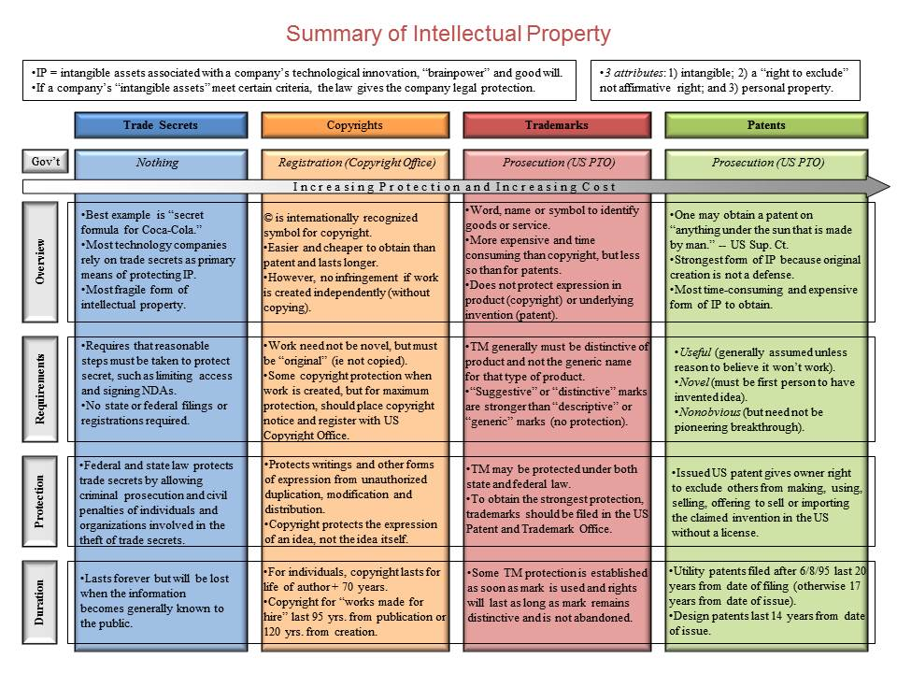

Slide 50



Slide 51

Case of Nepal
Industrial Property (IP)
The Patent, Design and Trademark Act has authorized the Department to protect the industrial property like patent, design and trademark; Patents shall include new invention; principles and formulae; Design shall include physical shape and appearance whereas Trademark shall include the word, sign, picture or all three or combination between them to differentiate the product from the others.
The Department shall act as semi-judiciary unit in case of protection of industrial property as well as in the settlement of disputes and other administrative procedure.
The Department shall also act as a focal point of all the international organization/institution including World Intellectual Property Organization (WIPO). Besides the membership of WIPO, Nepal has received a membership for Paris Convention for Industrial Property.
Notes:
https://www.iponepal.gov.np/index.php

Slide 52
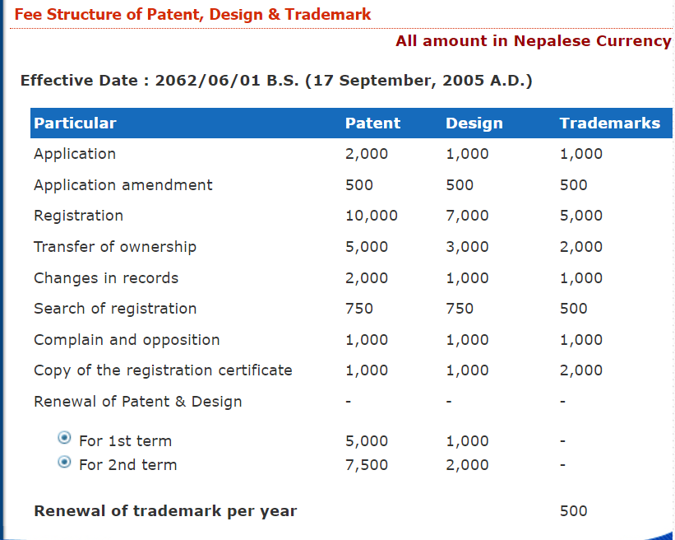
Case of Nepal

Slide 53
Case of Nepal: Patents
RIGHT OVER THE PATENT
Any person, willing to have rights on any patent, has to register such patent under the Patent Design and Trademark Act.
Any patent registered in the name of any person shall not be copied use used or utilized without the patentee's written consent .
Ownership of a patent can be transferred in any way to any person as movable property.
If any body does or attempt to do so or encourage to do any work against these rights of patentee may be punished with a fine by the order of Department and all the materials related with such offence shall be confiscated.
APPLY FOR ACQUIRING PATENT RIGHT:
Person willing to patent registered in his own name shall have to apply to the Department with following information including all other evidence
Name, address and profession of inventor.
In the case of the invention not invented by the applicant himself, the conditions acquiring such right from inventor by the applicant,
Method of operation or utilization of such invention
Principle or formula, if such patent is based on any principle or formula
Drawings and sketch of invention (if necessary)
Prescribed application fee as mention in schedule
UN-PATENTABLE INVENTION
If it has already been registered in the name of other
If the patent asked to be registered is not invented by the applicant himself and he has not acquired the right from the inventor
If the patent asked to be registered is found to cause adverse effect in health , conduct or morale or people in general or in the national interest
If it violates any prevailing laws of Nepal.
Notes:
https://www.iponepal.gov.np/index.php

Slide 54
Case of Nepal
EXAMINATION OF PATENT APPLICATION
Department upon submission of an patent application examine the invention whether it is new or not, it is useful to the people in general or not
If it deems necessary, Department takes the advice of experts of related field
Basically, Department fallow the principle of Novelty, Industrial applicability, and Inventive step to examine
CERTIFICATES OF REGISTRATION
If Department found the patent application is patentable after examination provide certificates to the applicant
Applicant shall pay a registration fee as prescribed in schedule.
PUBLICATION OF REGISTERED PATENT
Department shall publish all patents, except those to be kept secret for national interest in journal
Anybody willing to see or take a copy of the statement, drawing or sketch of a patent published in journal may see or take a copy of such patent document on payment of a fee as prescribed.
OPPOSITION
If any body has any complain upon any patent he may lodge such complains to the Department within thirty-five days from the date on which the patent is seen or a copy of such patent document is taken.
Upon receipt of the complain Department take necessary action through an investigation.
TERM AND RENEWAL
Patentee shall have his right on the patent for a period of seven years from the date of registration.
The patentee shall renew the patent within 35 days from date of expiry having paid the fee mention in schedule.
Renewal of a patent may be made for two times of seven years.
Notes:
https://www.iponepal.gov.np/index.php

Slide 55
Case of Nepal
RIGHT ON DESIGN
Any body may have a right on a design of any goods under the act, which is made or caused to be made by him, and has been registered in Department.
Owner ship of a design can be transfer.
No body shall make any goods by using other’s design or in a way to manipulate the people in general and copying such design without written consent of the person in whose name design is registered.
APPLICATION FOR REGISTRATION OF DESIGN
Person willing to get registered a design of any goods made or caused to be made by him shall apply to the department along with a description, drawings and sketch of design and four copies of its model.
Applicant shall submit prescribed application fee.
REGISTRATION OF DESIGN
The Department after examination of any application shall register the in name of applicant
The applicant shall pay prescribe registration fee to the Department to obtain the certificate of registration.
Notes:
https://www.iponepal.gov.np/index.php

Slide 56
Case of Nepal
UN-REGISTRABLE DESIGN
The design shall not be registered;
If, it is deemed to make adverse affect in the dignity of any individual or institution or,
It makes bad affect in the well being and morale of the people in general or in the national interest, or
If such design has already been registered to the name of other person
Department also looks whether the design to be registered is new and original.
Department may cancel the registration of any design in case if it deems that there is a situation of above.
TERMS AND RENEWAL OF DESIGN
The design holder shall have his right on the design for a period of five years from the date of its registration.
The design holder shall renew the registration of design within 35 days from the date of expiry.
PENALTY TO THE VIOLATOR
If any body violates the rights of registered design holder may be punished with a fine by the order of the Department and all the goods related with such offence shall be confiscated.
Notes:
https://www.iponepal.gov.np/index.php

Slide 57
Case of Nepal
RIGHT ON TRADEMARK
Any body may have a right on any trademark of his trade or business under the act having it registered in the Department.
Nobody shall use or copy any trademark in a way of manipulating the people in general without a written consent of person in whose name the trademark is registered.
Ownership of a trademark can be transferred to other with a permission of the department.
APPLICATION FOR THE REGISTRATION OF TRADEMARK
One who is willing to get registered any trademark of his trade or business under the act shall apply to the Department in a prescribe format along with:
Copy of registration or license of the business for product or service in which trademark is used or intend to use.
Four copies of model of trademark.
Authorizations letter if somebody has been authorized to act on behalf of the owner to register the trademark.
If the applicant is a foreigner, certified copy of any foreign registration certificate and address for service in Nepal must be submitted with application.
Receipt of payment of prescribe application fee.
Separate application shall be submitted for the registration of trademark of different categories goods or services.
Notes:
https://www.iponepal.gov.np/index.php

Slide 58
Case of Nepal
CONDITION FOR REFUSAL TO REGISTER THE TRADEMARK
If such trademark is deemed to make adverse effect in the dignity of any individual or institution,
If such trademark make bad effect in the well being and morale of people in general or in the national interest,
If such trademark effects in the goodwill of trademark of any other person , or
If such trademark has been already been registered in the name of the other person.
The trademark, which is contrary to the principle, norms and international conventions of industrial property.
CLASSIFICATION OF GOODS AND SERVICES
Government of Nepal, for the purpose of registration of trademark relating to any goods and any types of services may classify such goods and services.
International Classification of Goods and Services for the purpose of the registration of Marks (Nice Classification) is applied to this effect.
REGISTRATION OF TRADEMARK
After examination if it is found registrable, The Department register the trademark in the name of applicant and issue a certificate.
The applicant shall pay a registration fee of the trademark as prescribed in schedule.
TERM AND RENEWAL OF TRADEMARK
The registered trademark holder shall have his right on the trademark for a period of seven years from the date of registration.
The registered trademark holder shall renew the trademark within 35 days from the date of expiry.
Notes:
https://www.iponepal.gov.np/index.php

Slide 59
Case of Nepal
CANCELLATION OF TRADEMARK
The Department may cancel the registration of a trademark in case of that there is a condition of refusal to register.
The Department may cancel the registration of trademark in case if it is not put into use within one year from the date of registration.
PUBLICATION OF TRADEMARK
The department may publish the registered design and trademark and a statement in regard to their renewal and cancellation of registration for the information of the people in general.
OPPOSITION AND COMPLAIN
Any person if he has any complain on the statement publish by the department concerning the design and trademark may lodge a complain to the department within 35 days of such publication. The department shall take necessary action through examination of such complain.
PENALTY AND COMPENSATION
If anybody violates right of registered trademark owner and use the trademark which is cancelled by the department he may be punished with a fine by order of the Department and all the goods related with such offence shall be confiscated.
In relation to the patent, design or trademark registered under the act, the Department may cause to pay a reasonable amount of the loss, incurred through the violation of the act by any body, to the person who had really been suffered from such loss, and whose name the patent, design and trademark was registered, from the person of such violation, as a compensation.

Slide 60
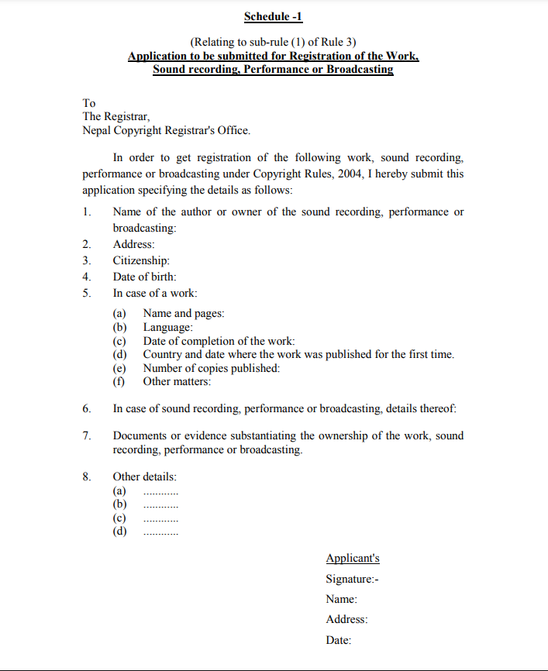


Case of Nepal
Notes:
http://nepalcopyright.gov.np/

Slide 61
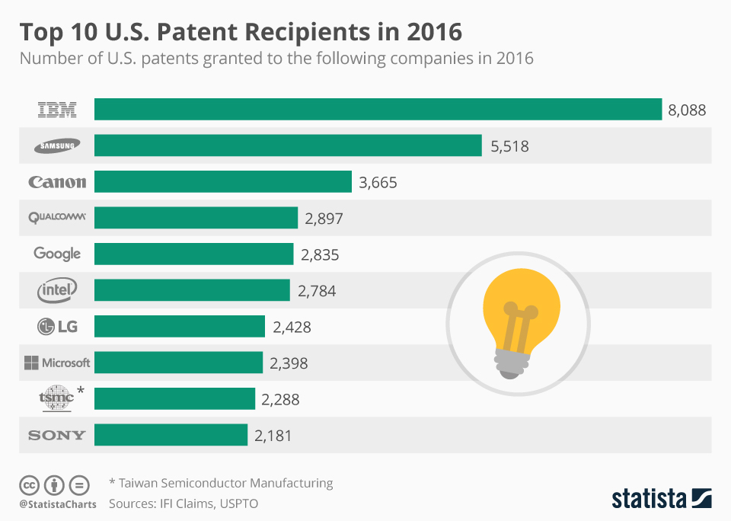

Slide 62
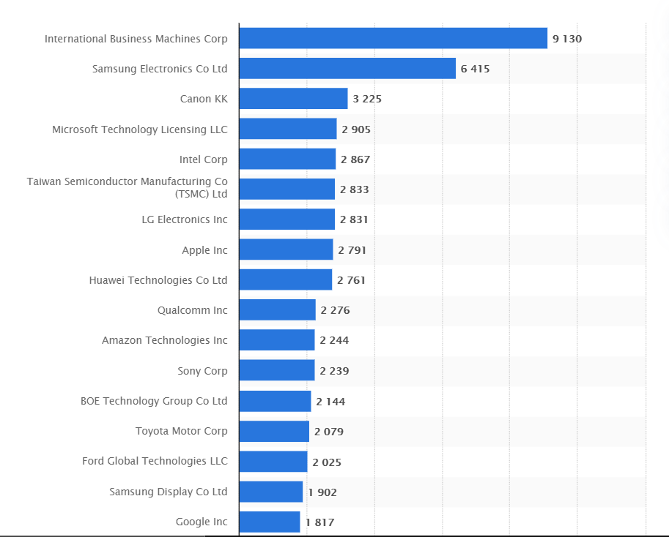

Slide 63
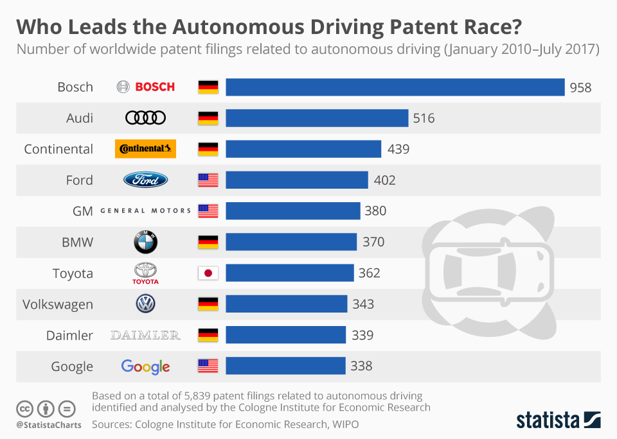

Slide 64
Creativity
Nature of Creativity
Creativity is the ability to produce new and useful ideas
Playing with imagination and possibilities – leading to a new and meaningful connections and outcomes
Creativity comes out of imagination by interacting with ideas, people and environment
Creativity is largely independent of age, sex and education
Creativity may be out of proportion of number so more people does not mean more creativity

Slide 65
The Creative Process
Preparation
Structure the problem, collect information, understand relations and effect, solve sub-problems and explore all possible combinations and solutions
Frustration and Incubation
Failure to solve analytically leads to frustration and wants to leave it but subconsciously it incubates within
Inspiration or illumination
Possible solution to a problems occurs spontaneously – Isaac Newton
Verification
Solutions reveled or found must be verified – intuitions and insights may not always be correct

Slide 66
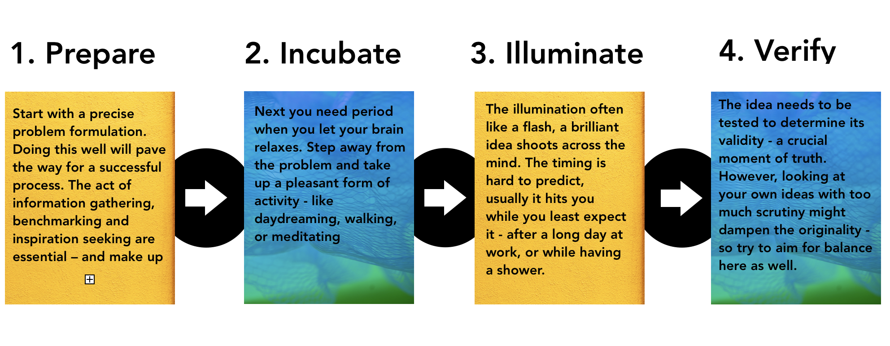

Slide 67
Brainstorming for Creativity
Brainstorming process
Brainstorming is “organized ideation”
It is a creative conference, ideally of 8 to 12 people
Requires about an hour for generating 50 or more ideas
No discussion during the brainstorming
No criticism is allowed for any idea
Ideas are recorded as stated

Slide 68
Other techniques
Nominal Group Technique
Tear Down approach
“And also” method – suggesting improvements
Collective Notebook method
Attribute listing approach
Mind mapping – a very powerful and widely used technique by Tony Burzan

Slide 69
Nominal Group Technique Structured Brainstorming
Silent generation
Round robin phase
Clarification
Voting and ranking
Tabulation

Slide 70
Nominal Group Technique
Structured method for group brainstorming that encourages contributions from everyone.
NGT is used when
Some group members are much more vocal than others.
Some group members think better in silence.
When there is concern about some members not participating.
When the group does not easily generate quantities of ideas.
When all or some group members are new to the team.
When the issue is controversial or there is heated conflict.

Slide 71
NGT - Procedure
State the subject of the brainstorming and clarify the statement as needed until everyone understands it.
Each team member silently thinks of and writes down as many ideas as possible in a set period of time (5 to 10 minutes).
Each member in turn states aloud one idea. Facilitator records it on the flipchart.
Continue around the group until all members pass or for an agreed-upon length of time.
Discuss each idea in turn. Wording may be changed only when the idea’s originator agrees. Ideas may be stricken from the list only by unanimous agreement. Discussion may clarify meaning, explain logic or analysis, raise and answer questions, or state agreement or disagreement.
Prioritize the ideas using voting or list reduction.

Slide 72
NGT – Rules and Consideration
No discussion is allowed, not even questions for clarification.
Ideas given do not need to be from the team member’s written list. Indeed, as time goes on, many ideas will not be.
A member may “pass” his or her turn, and may then add an idea on a subsequent turn.
Discussion should be equally balanced among all ideas. The facilitator should not allow discussion to turn into argument. The primary purpose of the discussion is clarification. It is not to resolve differences of opinion.
Keep all ideas visible. When ideas overflow to additional flipchart pages, post previous pages around the room so all ideas are still visible to everyone.

Slide 73
"Tear-down" Approach
Used by two people.
The first person (person A) must disagree with the existing solution to a problem and suggest another approach;
Next, person B must disagree with both ideas and suggest a third;
Then person A must suggest yet another solution
This "cycle continues until a useful idea clicks."
"And-also" Method
Person A suggests an improvement on the subject under study; person B agrees, but suggests a further improvement; this sequential improvement "continues until a sound solution is reached."

Slide 74
Collective Notebook method
Each member of a team is given a notebook with a problem statement and supporting material a month in advance.
Each day during that month, the team member writes one or more ideas in the notebook,
At the end of the month he/she selects the best idea along with suggestions for further exploration.
A problem coordinator collects and studies notebooks and prepares a detailed summary for distribution;
if necessary, all team members then participate in a final meeting.

Slide 75
Attribute listing approach
A person lists attributes of an idea or item
Then concentrates on one attribute at a time to make improvements in the original idea or item.
Forced relation approach
It tries to generate new ideas by creating a "forced relationship" between two or more usually unrelated ideas or items.

Slide 76
Mind Mapping
Tony Burzan invented Mind Maps in 1970
Uses brainstorming, sketching and diagramming
Start mind-map by writing the main topic in the center
Think about main factors, ideas, concepts or components directly related
Concentrate on these headings and main ideas
Repeat the process for all main ideas
Organize, analyze – connect the related ideas and concept
Review, annotate, organize and revise
Start writing to make it a final product of mindmapping

Slide 77

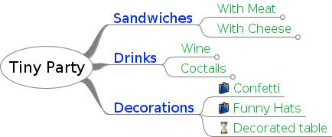
Mind Mapping: Example

Slide 78
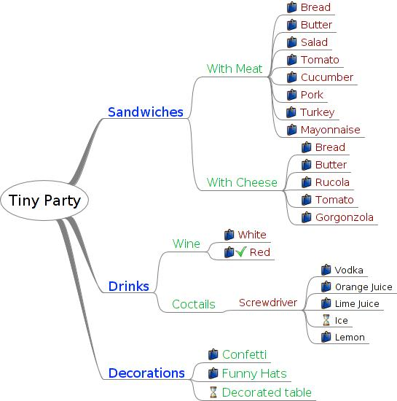

Slide 79
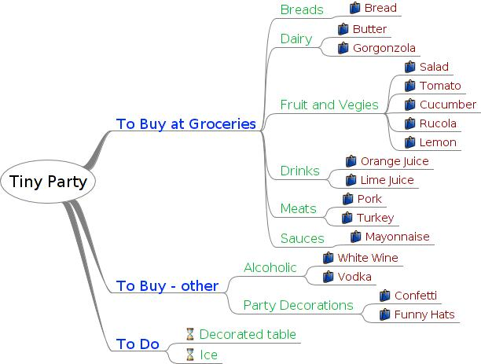

Slide 80
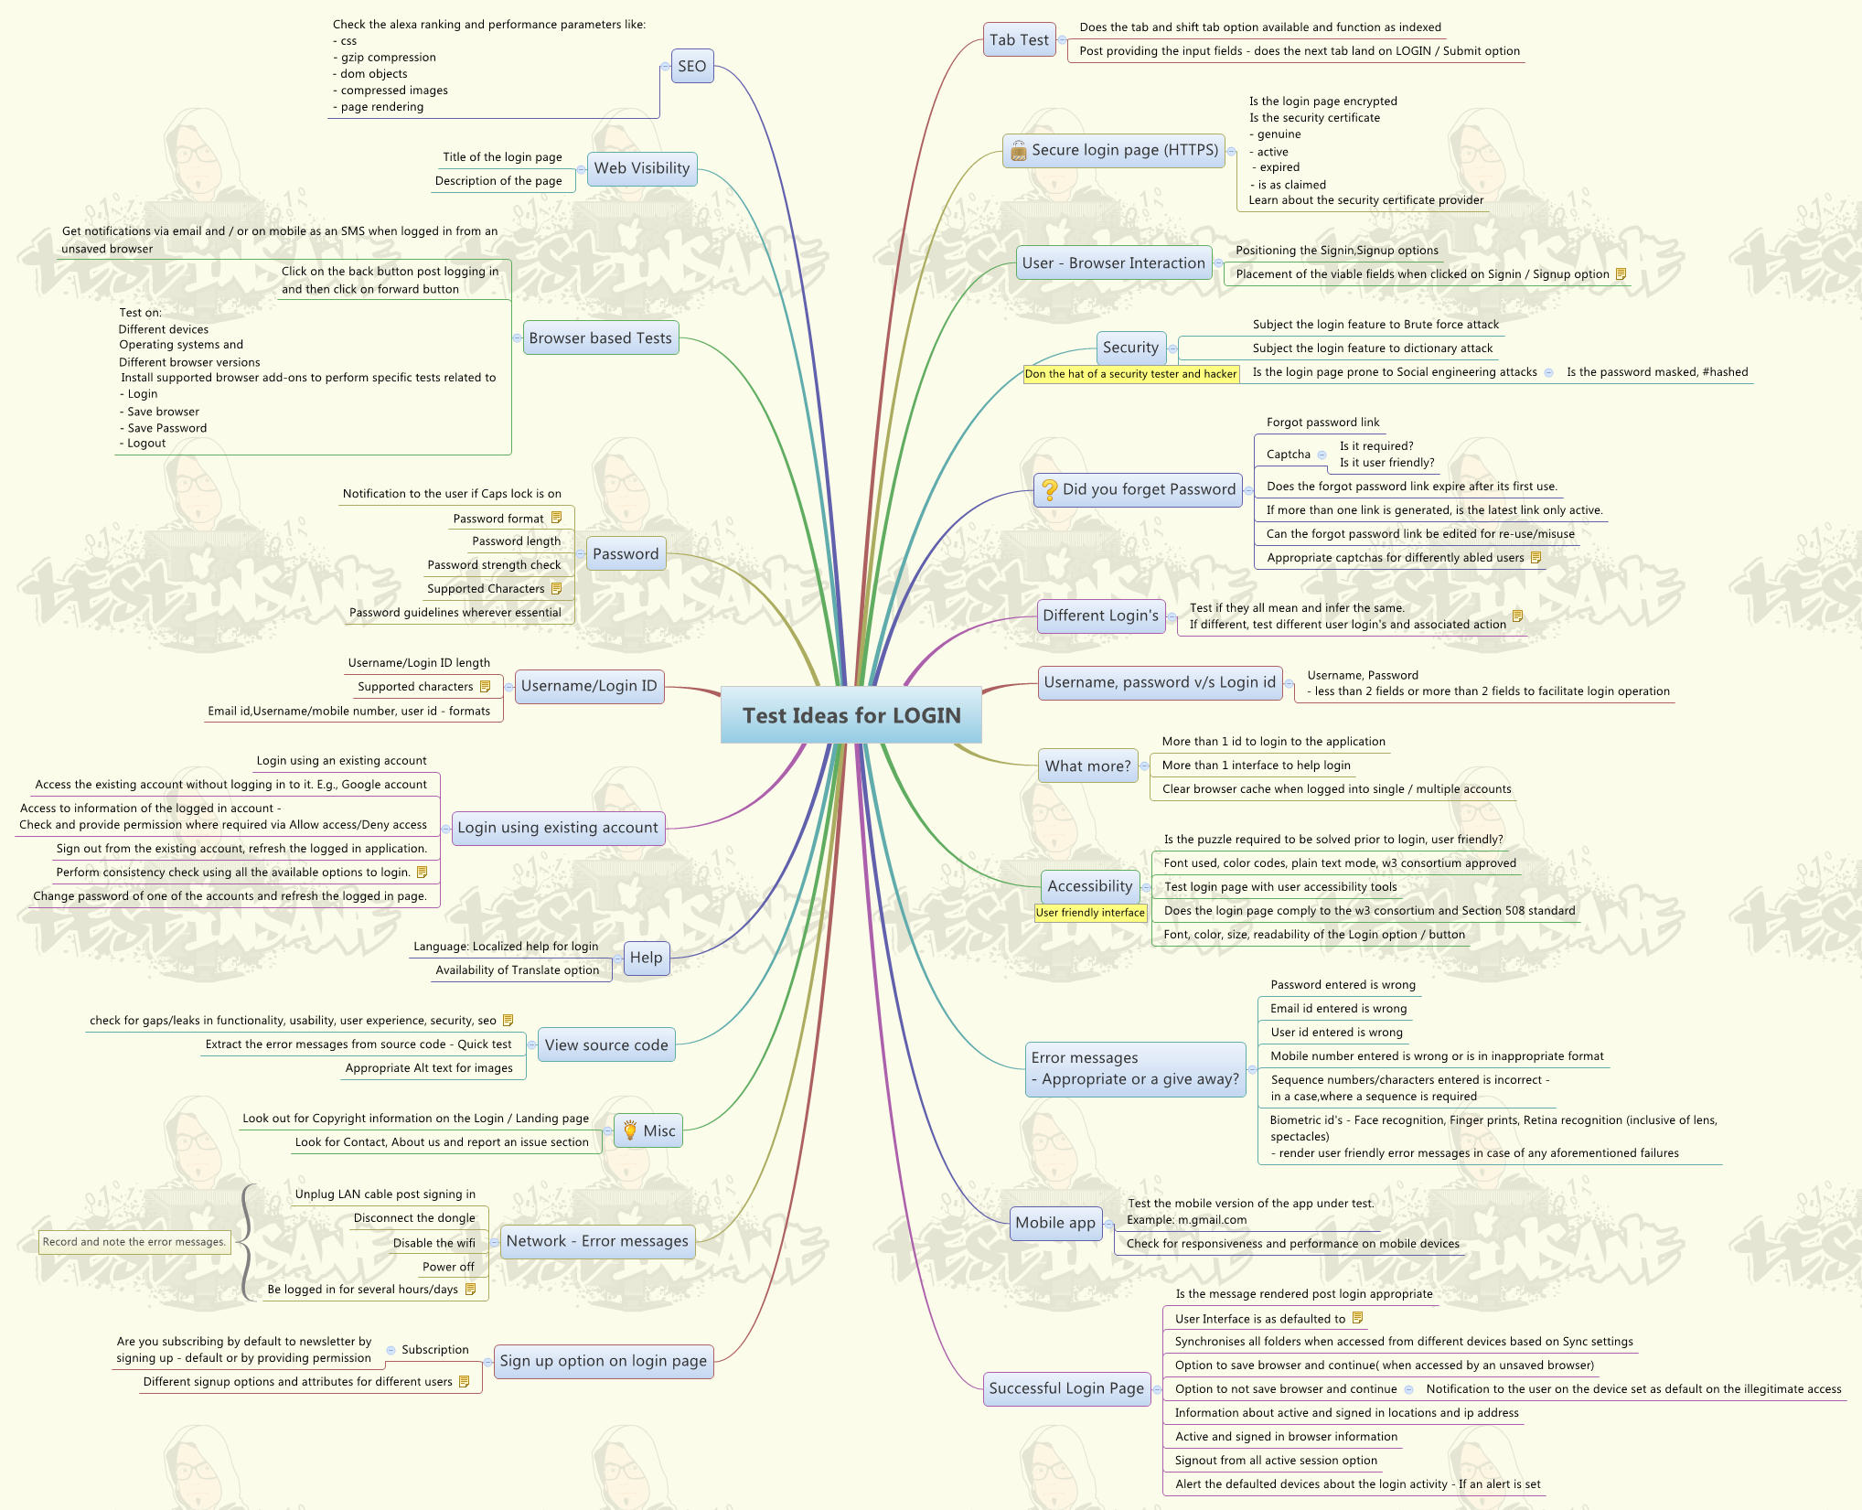

Slide 81
Characteristics of Creative People
Self confidence and independence – emotionally stable
Tend to reduce group pressure and conformity on rules
Curiosity – drive for knowledge on wide range of subjects
Approach to problems – open-minded, uncritical in the early stage
Personal attributes –
more comfortable with “things” than “people”
Not “joiners”
Broad intellectual interest
Enjoy intellectual games, practical jokes
More attracted by complexity

Slide 82
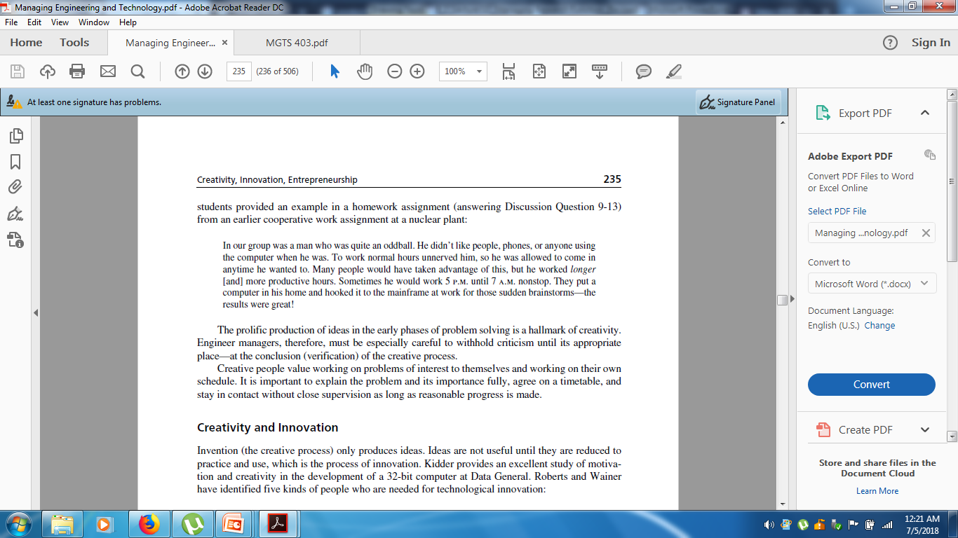
Providing a Creative Environment
Creative people are most effective in an organization that will
tolerate idiosyncrasies,
remove as much routine regulation and reporting as feasible,
provide support personnel and equipment as required, and
recognize and reward successes.

Slide 83
Creativity and Innovation
Invention (the creative process) only produces ideas.
Ideas are not useful until they are reduced to practice and use, which is the process of innovation.
Kind of people needed for technological innovation
Idea Generator – the creative individual
Entrepreneur – the person who “carries the ball”
Gatekeepers – research staff members who bring information to table
Program Managers – who manages without obstruction
Sponsors or champions – who provides financial and moral support usually in senior management

Slide 84
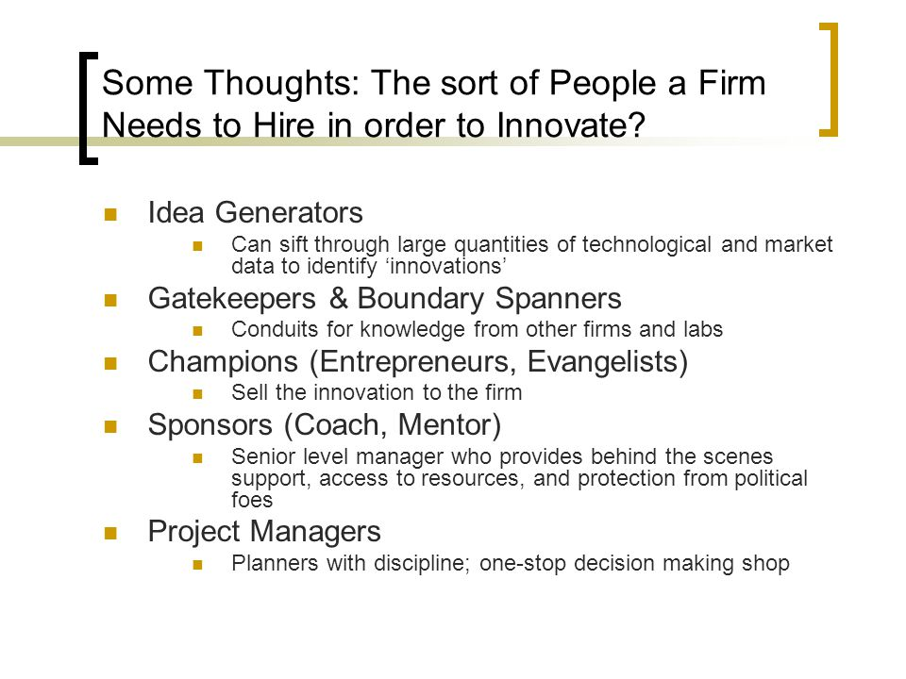

Slide 85
Technological Gatekeeper may be defined as expert both internal and external communication star having much higher incidence of exposure to the professional literatures, attend more conferences and has more professional affiliation.
Gatekeepers
(1) are more likely to read the more sophisticated (refereed) journals,
(2) are in contact with outside specialists, and
(3) form a network with other gatekeepers.
They often are high technical performers, usually produce more than their share of conference papers and refereed articles, and are likely to be promoted to first- and second-line supervision ahead of their peers.

